Slide 1
CPU Scheduling
By Ezequiel Valencia and Hunter Krasnicki

Slide 2
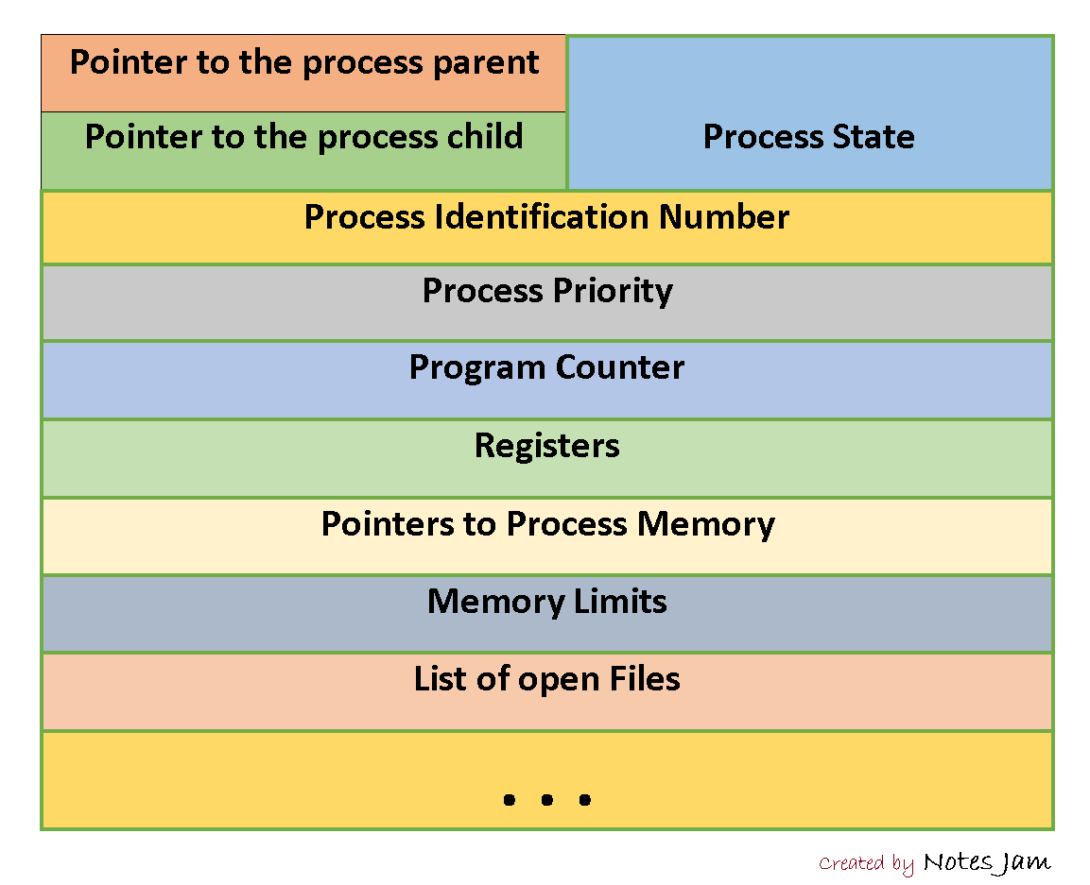
Processes Crash Course
Processes are instances of a program. It is the operating systems abstraction of execution. With a sequential processes being a program in execution. These processes have a data structure representation known as a process control block. Within PCB is all the bookkeeping knowledge to maintain the process.
https://1.bp.blogspot.com/-hRTr_-Aqkd0/W4PLcYiaDcI/AAAAAAAAGv0/B25xARlDeEQojZeOsJDPdHTBSQek4-RpQCLcBGAs/s1600/process-control-block.png

Slide 3

What is a CPU Scheduler
A CPU scheduler decides which process can currently have access to resources within the operating system. These resources can vary from executing instructions within the CPU to reading in information from a network card. Algorithms are used to decide which processes executes at which time.
https://img.freepik.com/free-vector/flat-people-asking-questions_23-2148919346.jpg?w=2000

Slide 4

Goal For CPU Scheduler Algorithms
All algorithms for scheduling are made with the following goals in mind.
Minimize Turnaround Time
Maximize Throughput
Short Response Time
Fairness
It would be best to have all goals met in full, however, that is currently not possible, and it is a balancing act of which goals take priority.
https://wpstudents.towson.edu/dbergh1-ebtm337/files/2016/12/get-with-goals-294nrhh.jpg

Slide 5
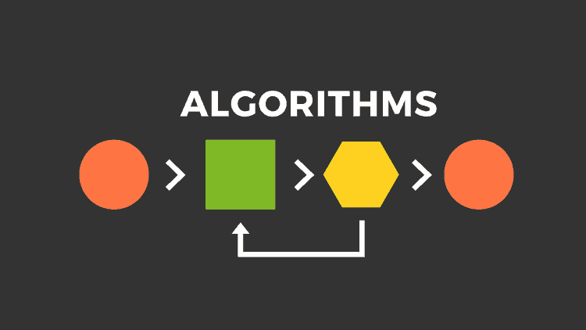
The different CPU Scheduling Algorithms
There is a large set of CPU scheduling algorithms, each having their own pros and cons. Some of the CPU scheduling algorithms discussed will be First In First Out, Shortest Job First, Round Robin, and Multilevel Feedback Queue.
https://pandorafms.com/blog/wp-content/uploads/2018/05/what-is-an-algorithm-featured.png

Slide 6

FIFO
First In First Out executes processes based upon their arrival time. A queue data structure is utilized to simulate a line within the OS. First process in the line was the first object to be added to the queue, and thus executes first. In contrast, last person in the line arrived after all previous processes, so it executes last.
Pros: Simple and no starvation.
Cons: Average waiting time can be large if small jobs wait behind longer jobs
https://www.sketchbubble.com/media/catalog/product/cache/1/image/720x540/c96a280f94e22e3ee3823dd0a1a87606/f/i/first-in-first-out-mc-slide4.png

Slide 7
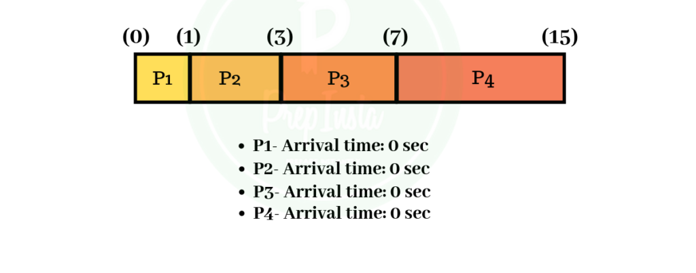
Non Preemptive: Shortest Job First
Orders all processes based upon execution time. Requires execution time of processes to be known preemptively.
Pros: Minimal average turnaround time
Cons: It is difficult to predict process execution time. If a longer process is chosen, then it will have to run until end of execution.
https://external-content.duckduckgo.com/iu/?u=https%3A%2F%2Fprepinsta.com%2Fwp-content%2Fuploads%2F2019%2F08%2Fsjf1-1-1024x597.png&f=1&nofb=1&ipt=abd3d6576b09e33c10144221c3dab2684f3f19de38bd799ab68300f3b4b0c8aa&ipo=images

Slide 8
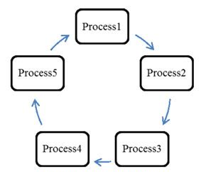
Round Robin
Burst based execution. When the process first joins the execution queue, it immediately receives a burst of execution time. A queue for every type of resource is created (I/O, CPU, etc…). The queue itself is cyclic, meaning that if a process is not done executing, it is placed as last again within the queue.
Pros: Allows for an immediate response from the process executing.
Cons: Turnaround time can be terrible for longer execution times
http://www.computerscijournal.org/wp-content/uploads/2015/12/Vol08_No3_Hyb_Vin_Fig2.jpg

Slide 9
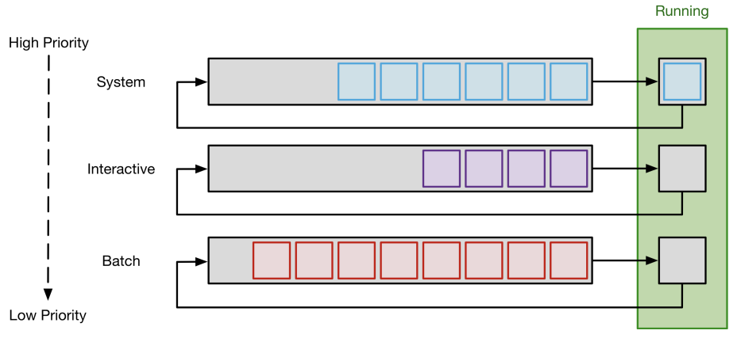
Multilevel Feedback Queue
Assigns processes to differing levels of priority based on process behavior. Processes of higher priority are always scheduled first.
Priority can be elevated or lowered based upon a variety of factors, though typically they are specification by user, blocking frequency, time-slice utilization
Pros: Ensures desired tasks are attended to more frequently (i.e. high-interactivity tasks like keyboard input)
Cons: Can lead to process starvation if priorities are inefficiently managed.
CPU Scheduling - University of San Francisco. https://www.cs.usfca.edu/~mmalensek/cs326/schedule/lectures/326-L10.pdf.

Slide 10
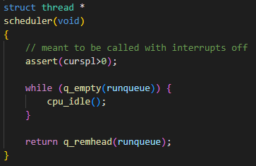
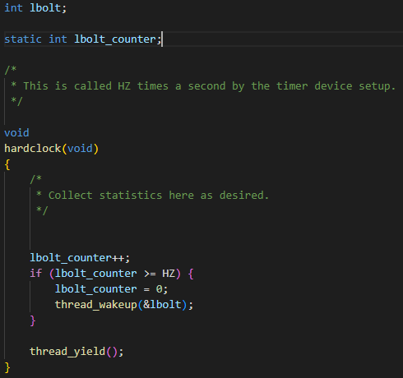
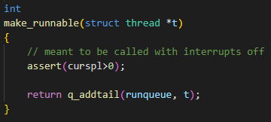
OS 161 CPU Scheduler
Scheduler.c
By default, OS161 uses a very basic round-robin scheduling algorithm for its CPU scheduler.
Threads are inserted into the queue in a FIFO order, running for a short burst as specified in hardclock.c. Once their time-slice is up, they are forced to yield to another thread.
Hardclock.c

Slide 11
Modification to Scheduler
We elected to implement a very basic version of a multi-level feedback queue. Where each thread is given a default priority that shifts given a process’s tendency to block or sleep.
If a thread blocks or sleeps, it is assumed to be ‘more interactive’, and thus have its priority raised.
Conversely, if a thread consumes its time-slice, we can assume it doesn’t use external resources, and as such is ‘less interactive’, thus its priority is lowered.
NOTE: Each of these queue-levels are using the same time-slice and algorithm (Round-Robin). This will become relevant later.

Slide 12
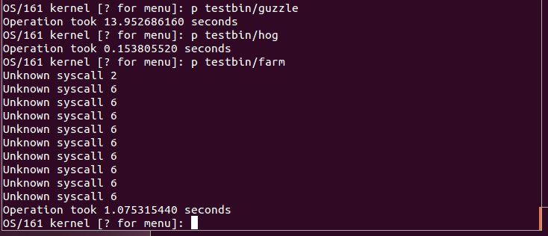
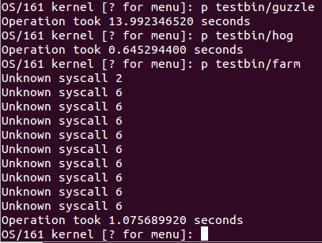
Tests
Hog: A program that ‘hogs’ the CPU, and tests turnaround time of single process.
Farm: Runs multiple different processes with multiple “pigs” and one “cat”. It tests execution of multiple programs, the switch between different processes, and priority implementation within queues.
Guzzle: Similar to Farm, but is more resource intensive.
Round Robin
Our MLFQ

Slide 13
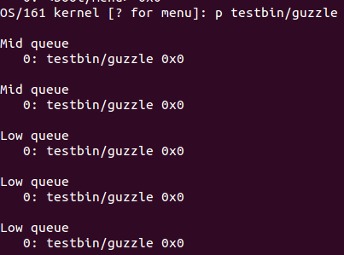
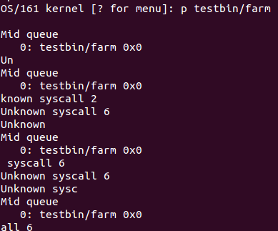
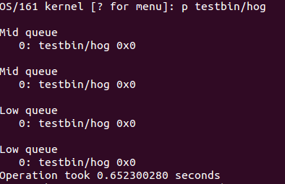
Queue Transitions
During these tests the priority of the processes changed, and this was displayed whenever it transitioned into medium and low priority. The results make sense for the transition occur after a couple of executions of the process for these process intensive tests.
Guzzle
Farm
Hog

Slide 14
Takeaways
So what happened? Why is it that MLFQ overall had worse performance than a standard RR, most notably in hog.c ?
Simple, because hog.c, given its tendency to run out its time-slice, will be forced to a lower priority, giving way to other processes that will run before it is allowed to.
Round Robin
Our MLFQ

Slide 15
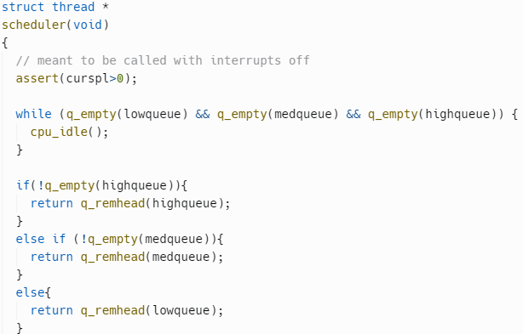
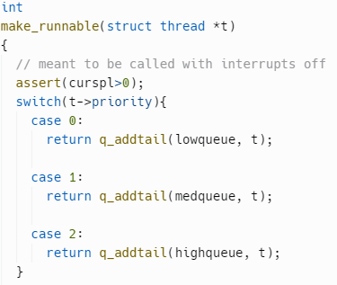
Takeaways cont.
Why did the other programs have similar run times to RR then?
Well, because they are running RR!
Remember, each queue is running a typical RR algorithm, and given that in the presence of other programs they aren’t likely to be forced to low priority, they will have similar performance to a typical RR scheduler.
Hence why only hog.c becomes noticeably slower!

Slide 16
Closing Remarks
How do we fix this?:
Equip priority queues with different algorithms
Sometimes it’s not always optimal to be using RR
Give higher priority queues larger time slices through hardclock.c
Ensures we spend less time swapping in-between queues
Reset priorities after a given time using a counter in hardclock.c
Ensures certain processes aren’t stuck in the low queue like hog.c

Slide 17
Conclusion
Multi-level Feedback Queue is a powerful CPU scheduling algorithm that requires careful implementation and tuning in order to perform optimally against typical algorithms.
Our implementation showcases a simple multi-level feedback queue using a RR method that, as expected, performs worse with cases such as hog.c, as it is a CPU bound process. Yet similarly to a typical RR setup with I/O bound processes. Owing to the strengths and weaknesses of the algorithm in such an implementation.
Through previously mentioned improvements, MLFQ can maximize the utility of each other algorithm, whilst simultaneously allowing for more interactive or important processes to keep running. Doing so through careful and dynamic management of task priorities.

